Slide 1
Machine Learning in Bioengineering Application BIOE 396/496 Fall 2021

Slide 2
About the course
Expectations
Logistics
Resources
Interactive teaching

Slide 3
Understand the physical principles of various biomedical data modalities
Identify practical problems in objective analyses of biomedical data
Understand the theoretical knowledge and background underlying the use of machine learning methods for biomedical applications
Understand the practical benefits and limitations of various analysis methods and identify the best solution for specific problems

Slide 4
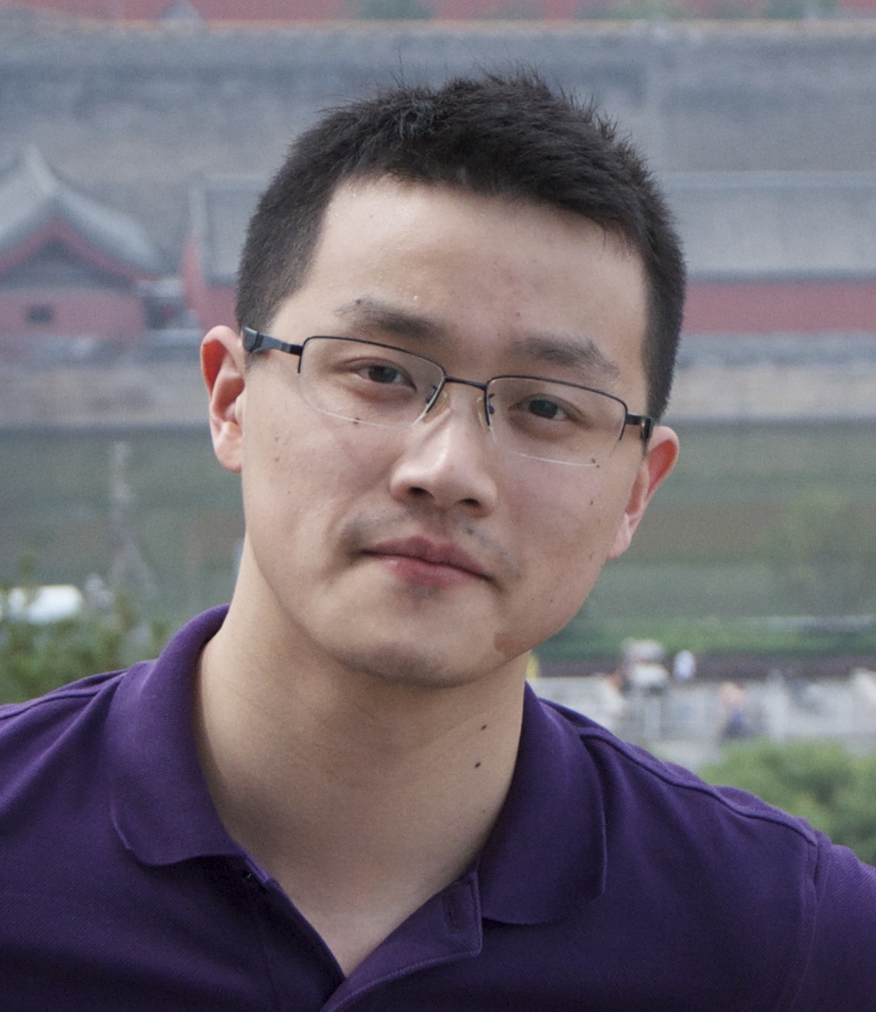
Prof. Yu Zhang
BioE and ECE
Biomedical Imaging Computation
Machine Learning
Email: yuzi20@lehigh.edu
Phone: 571-376-8953
Office: Room 343, Building C, Mountaintop
Office hour: TBA

Slide 7
Introduction to biomedical data and systems
Overview of machine learning and AI
Data preprocessing and normalization
T-test and its applications for biomedical data
Correlation and linear regression
Linear discriminant
Logistic regression
Performance metrics: R-square, sensitivity, ROC curve
Overfitting, regularization, and model selection
Cross-validation, permutation test

Slide 8
Support vector machine
Applications of supervised learning in bioengineering
Dimensionality reduction, principal component analysis (PCA)
Independent component analysis (ICA)
Applications of PCA and ICA in biomedical data analysis
Brain network modeling
Unsupervised clustering
T-SNE for biomedical data visualization
Basic concepts of neural networks
Autoencoder
Convolutional neural network

Slide 9
Assignments (N=3)
Individual assignment 1: Linear regression/classification for prediction tasks in bioengineering
Individual assignment 2: Dimensionality reduction and data visualization
Individual assignment 3: Model selection and cross-validation
Final project presentation: An independent project will apply analysis methods to a research question of interest in the bioengineering discipline. This project can either be related to ongoing research in a lab or can replicate a published study.

Slide 10
Grade Breakdown
Individual assignment 1 (15%)
Individual assignment 2 (15%)
Individual assignment 3 (15%)
Final project presentation (55%)

Slide 12
Additional courses:
Machine Learning by Andrew NG – Stanford University
Recommended books:
Biosignal and Medical Image Processing, 3rd John Semmlow, CRC press, 2014
Pattern Recognition and Machine Learning, by Christopher Bishop, Springer, 2006
Machine Learning for Healthcare Application, by Sachi Mohanty, G. Nalinipriya, Om Prakash Jena, Achyuth Sarkar, Wiley press, 2021
Deep Learning for Biomedical Applications, 1st edition by Utku Kose, Omer Deperlioglu, D. Jude Hemanth, CRC press, 2021

